Slide 1
Celebrating the Magic of Teachers
Dr. Charles Severance - University of Michigan
School of Information / Informatics
www.dr-chuck.com

Slide 2
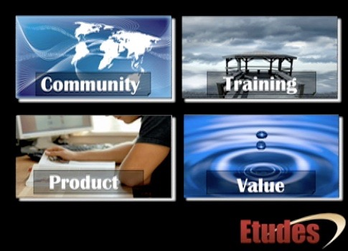
Welcome

Slide 3
A Wandering Tale...
One teacher’s experiences wrestling with technology over 15 years or so...

Slide 4

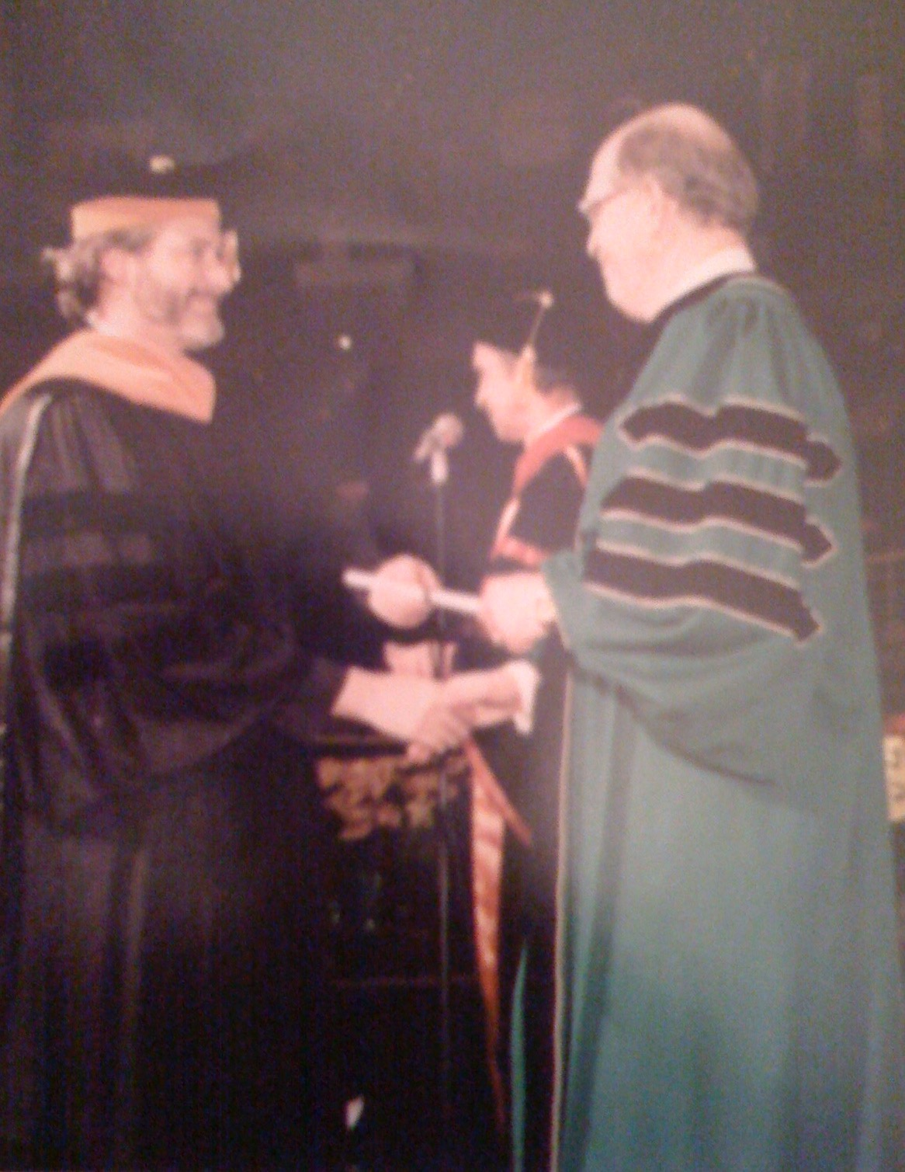
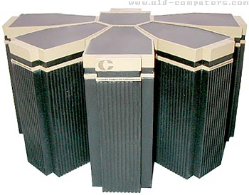
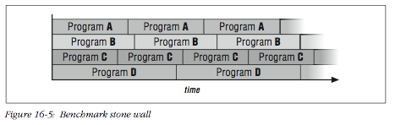
1996

Slide 5
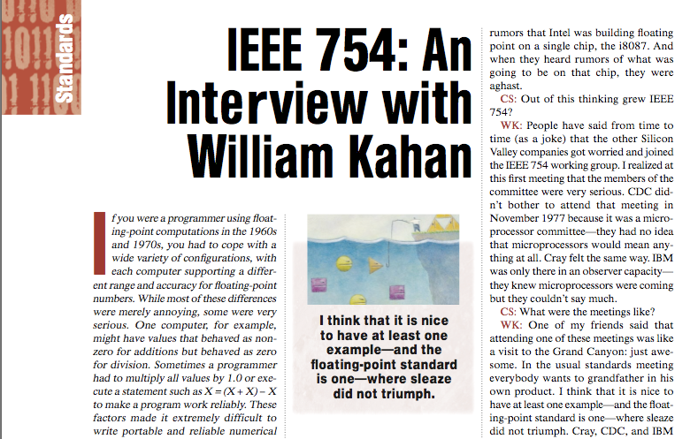
1996

Slide 6
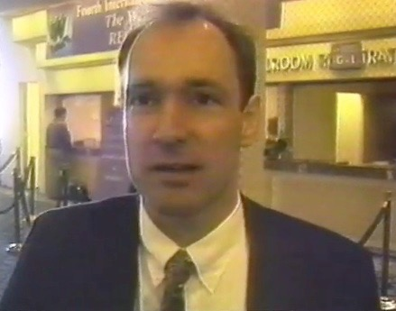
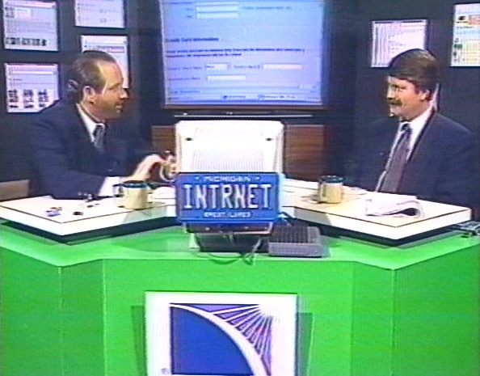
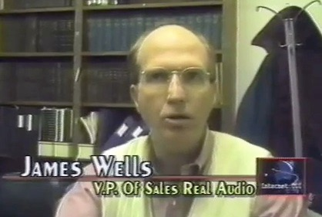
1996

Slide 7
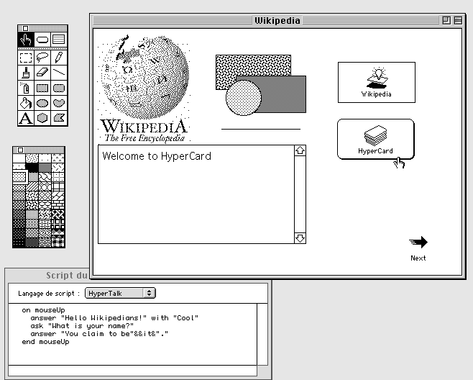
1996

Slide 8
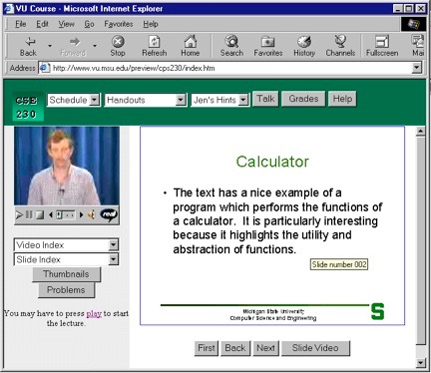
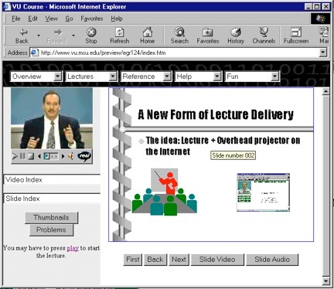
Sync-O-Matic
www.syncomat.com
1997

Slide 9
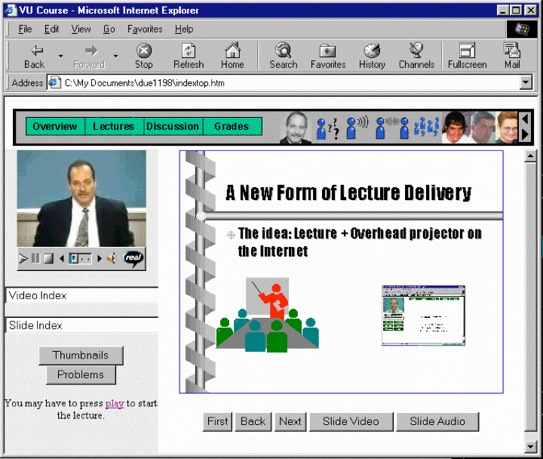
Title: Using Asynchronous, Web-based, Video to Humanize Distance Education
1998

Slide 10
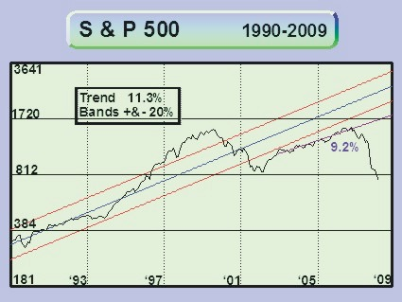
You are Here
1998

Slide 11

1999

Slide 12
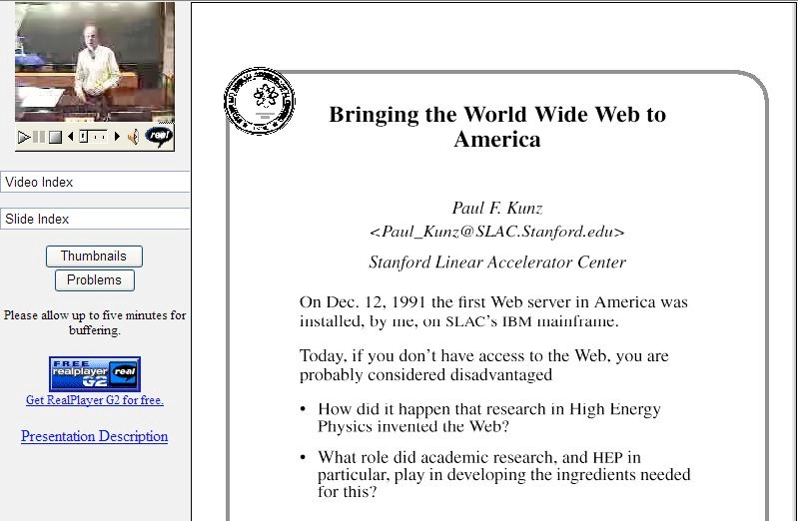
1999

Slide 13
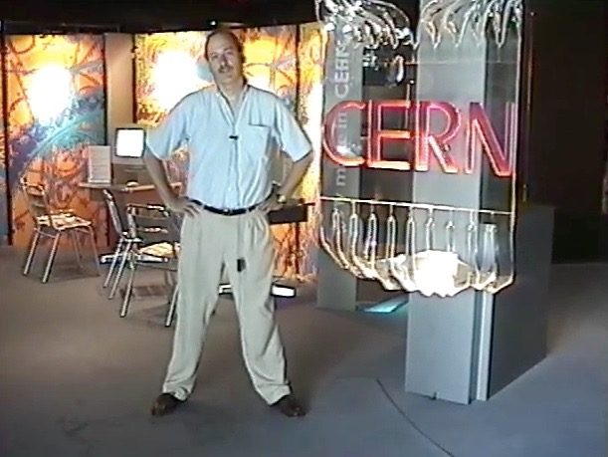
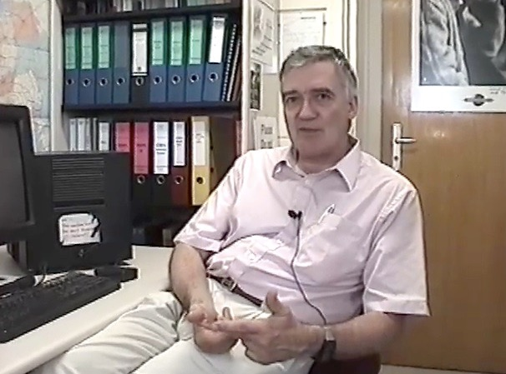
Robert Cailliau
co-Inventor of the
World-Wide Web
1999

Slide 14
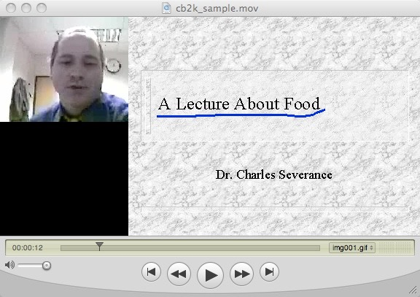
2000
http://www-personal.umich.edu/~csev/csev/projects/cb2k/index.htm

Slide 15

Microsoft Exchange + Learning Modules =
Microsoft Learning Network (MLN)
2001

Slide 16
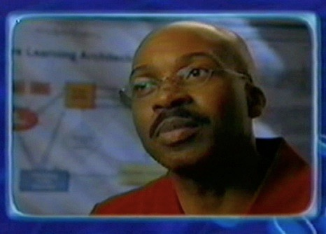
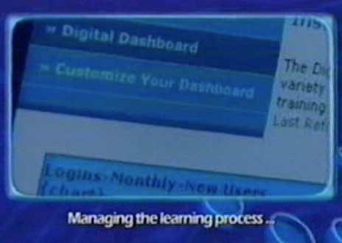
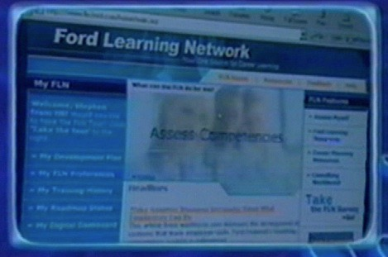

2002

Slide 17

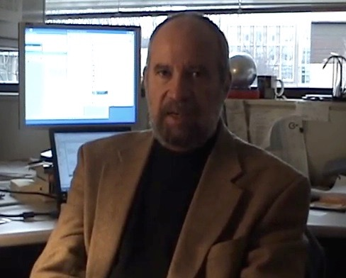
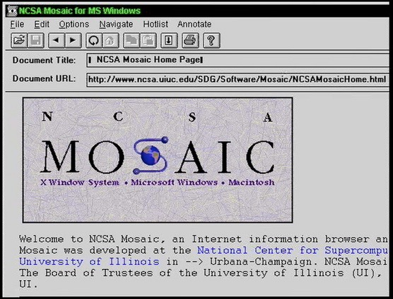
2003

Slide 18
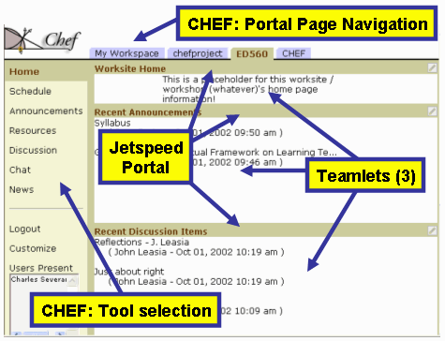

2003

Slide 19
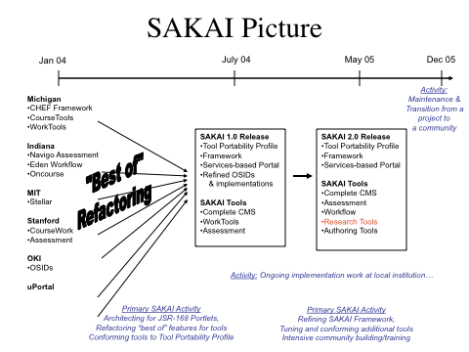
2003

Slide 20

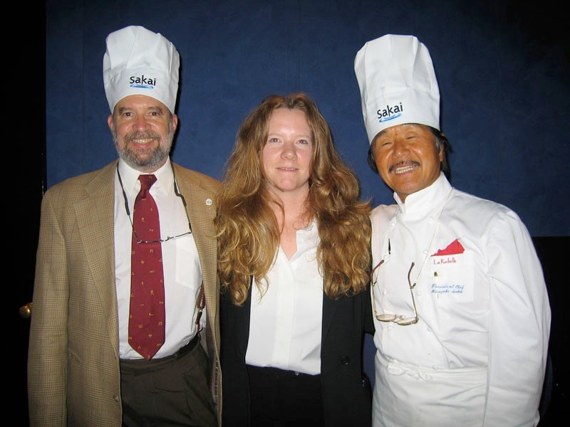
2004

Slide 21



Learning Tools Interoperability
2004

Slide 22
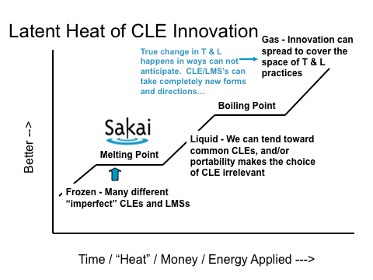
2004

Slide 23
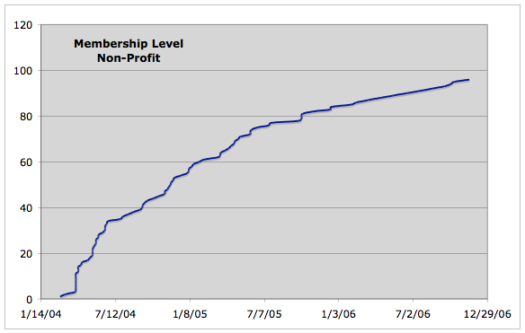


Slide 24






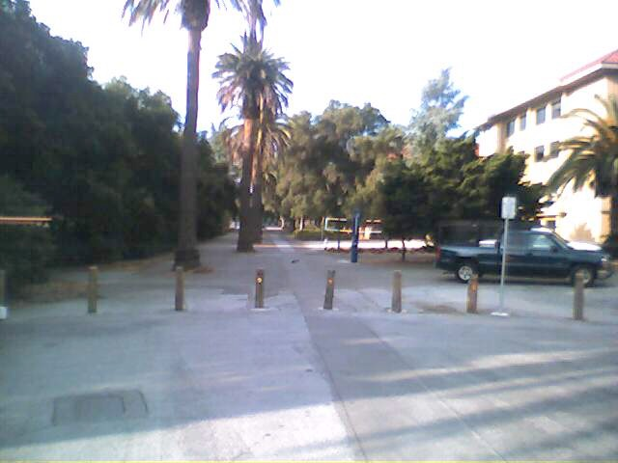
?????
2005
Common Cartridge

Slide 25
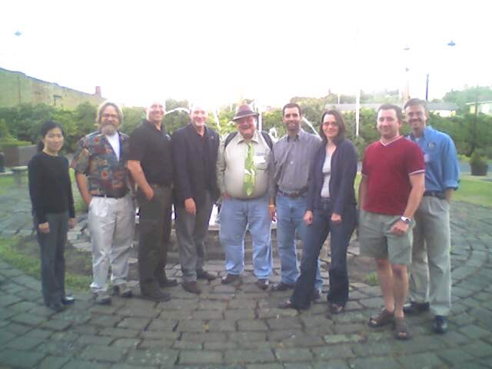
IMS Tools Interoperability
Demonstrator
Sheffield, UK
2005

Slide 26
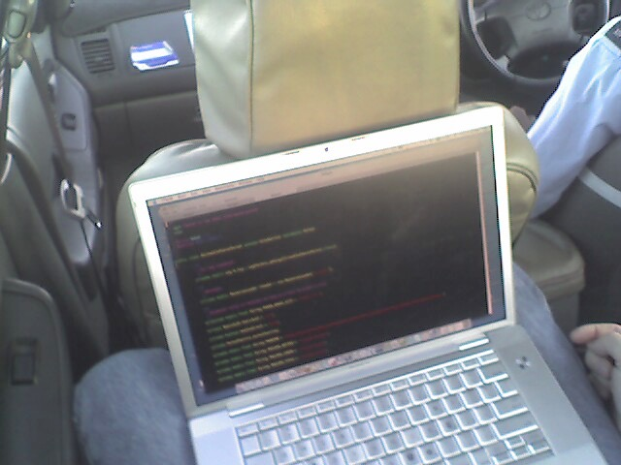

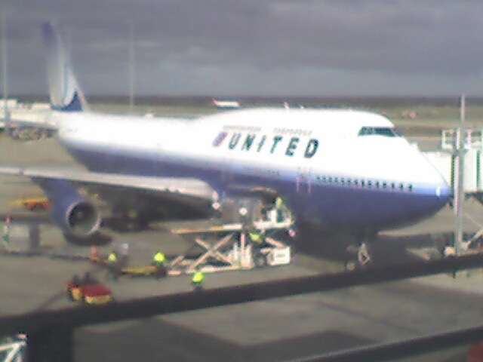
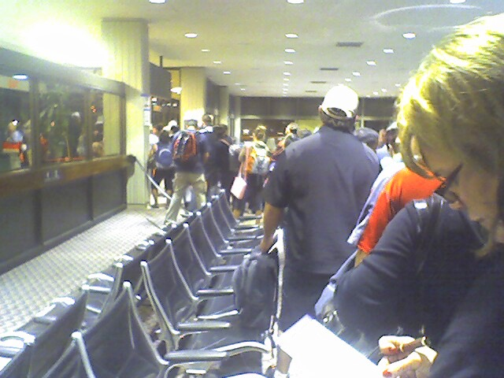
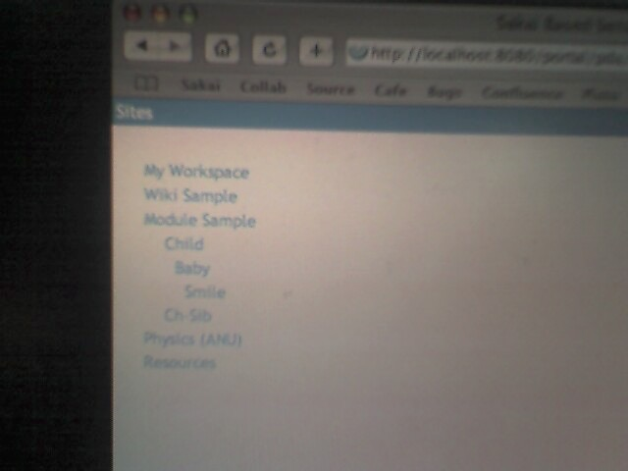
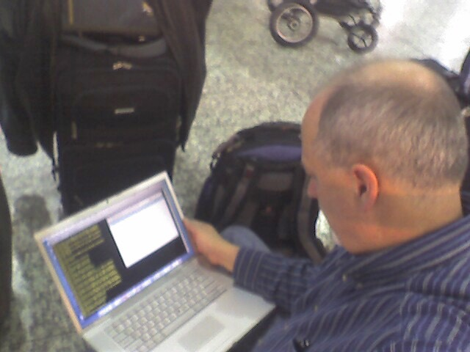
2006

Slide 27
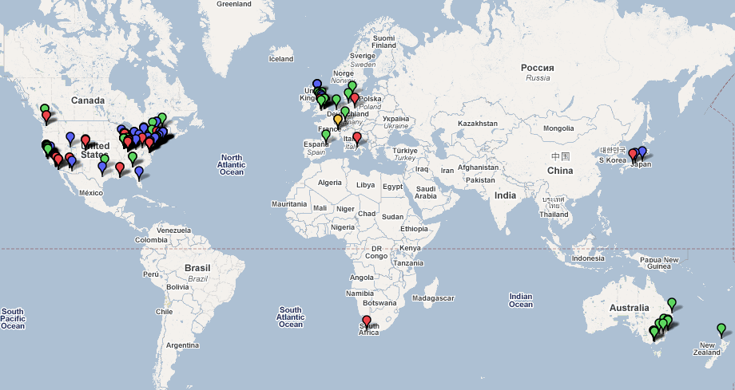


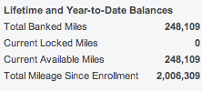
Dr. Chuck Travel 2004-2006

Slide 28

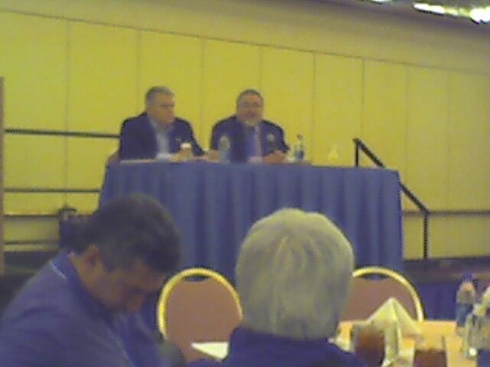
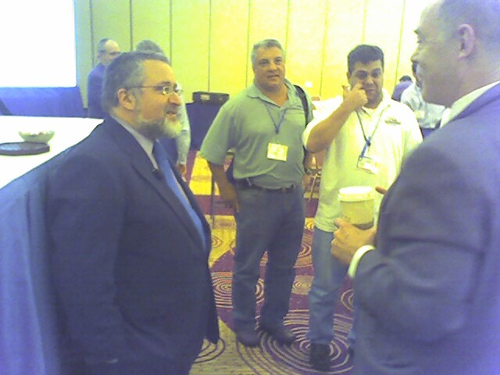
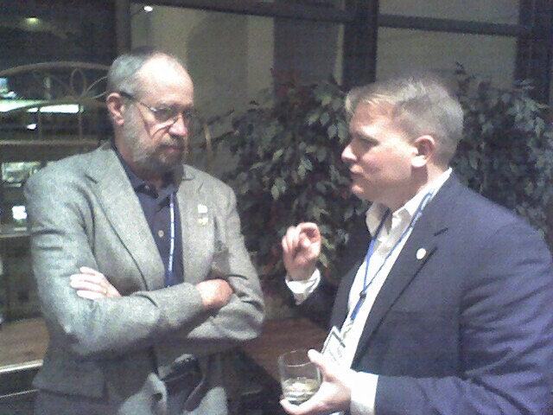
2006

Slide 29
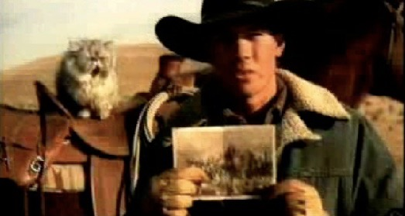
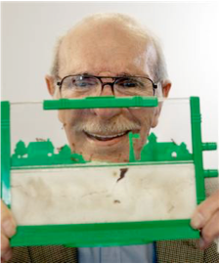
2007

Slide 30


Self-Service Exit Interview
Bring enterprise-level open source LMS into the Market
Collect bright worldwide developer community and achieve sufficient adoption for sustainability
Focus on ease of adding new tools
Create market to enable the free exchange between teachers
Get teachers writing tools
?
??
X

Slide 31
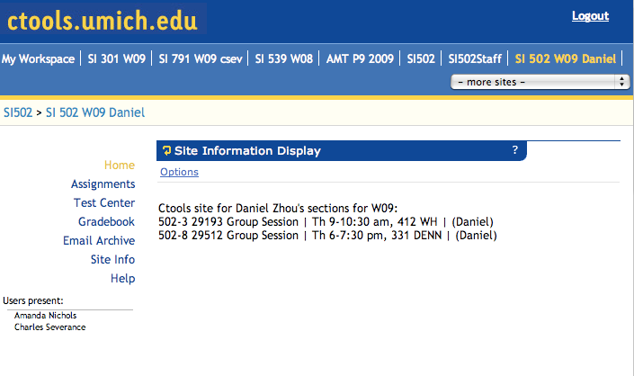

2007

Slide 32
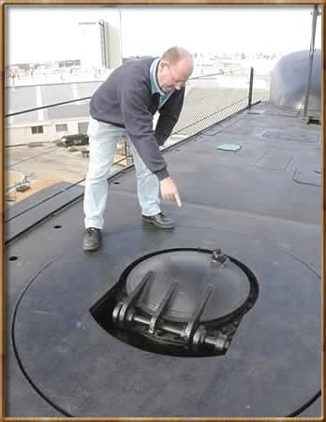
2007

Slide 33


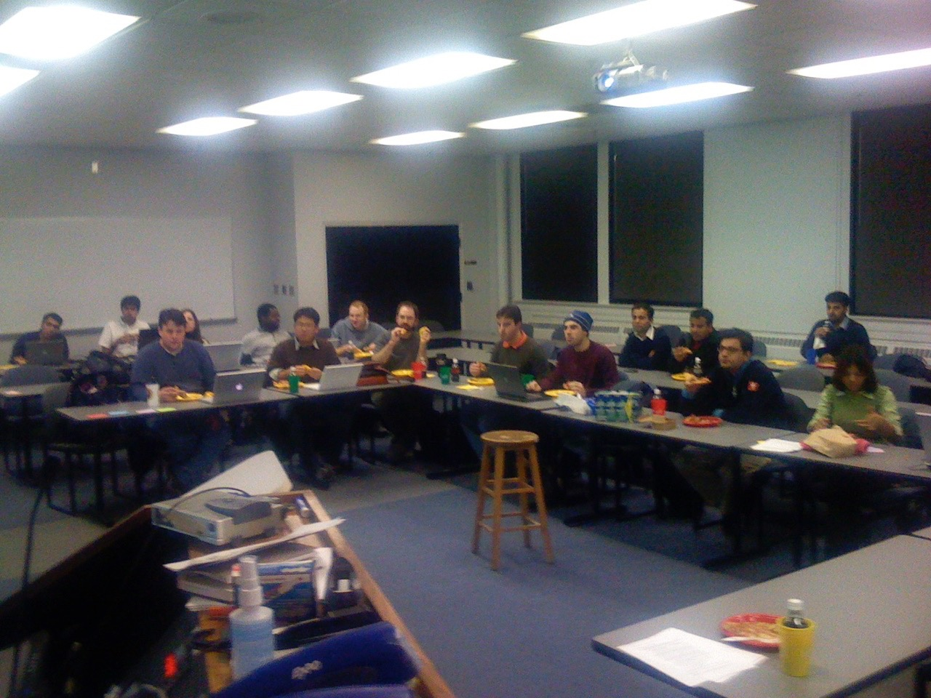
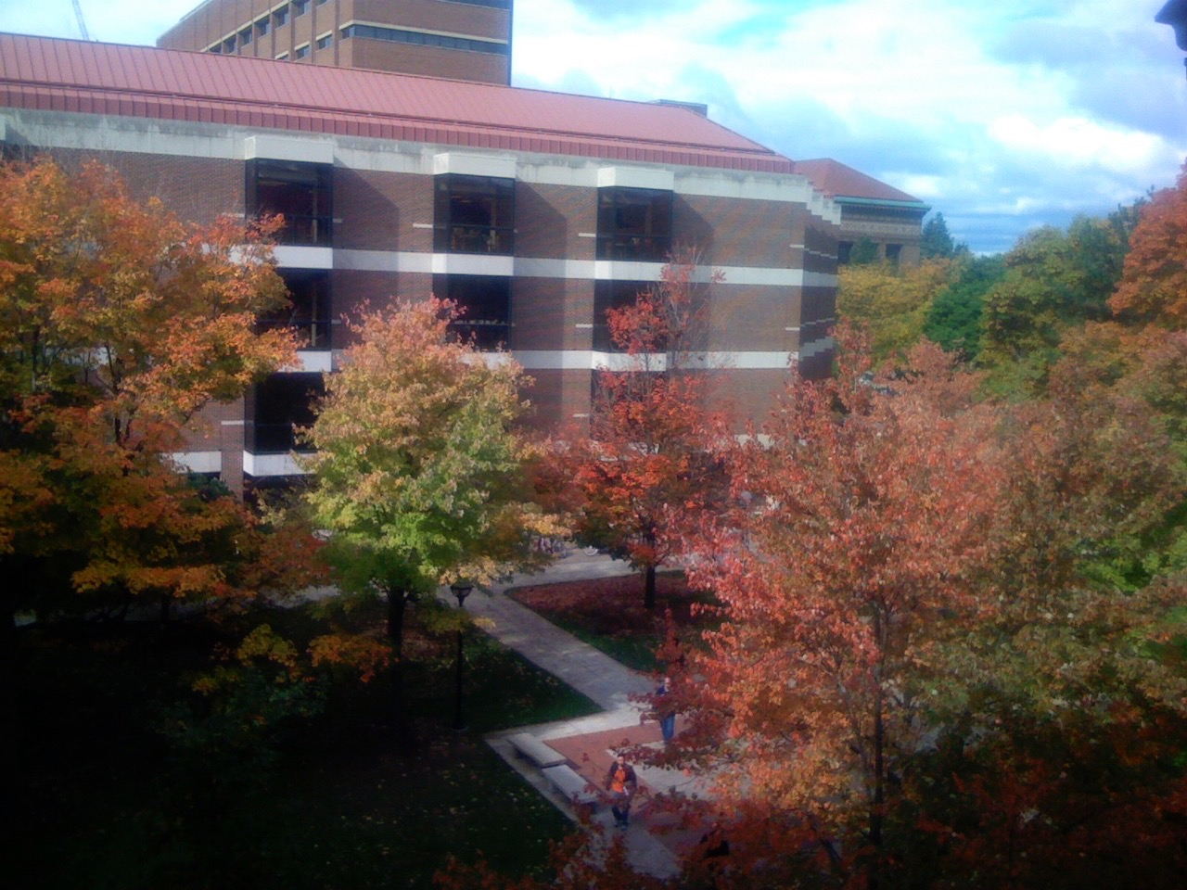
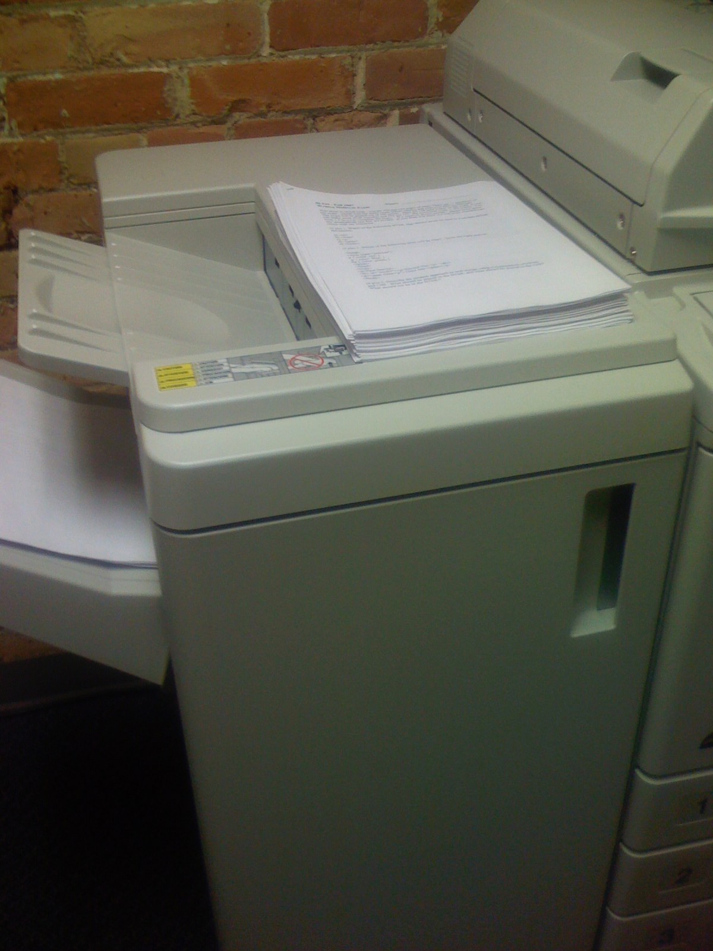
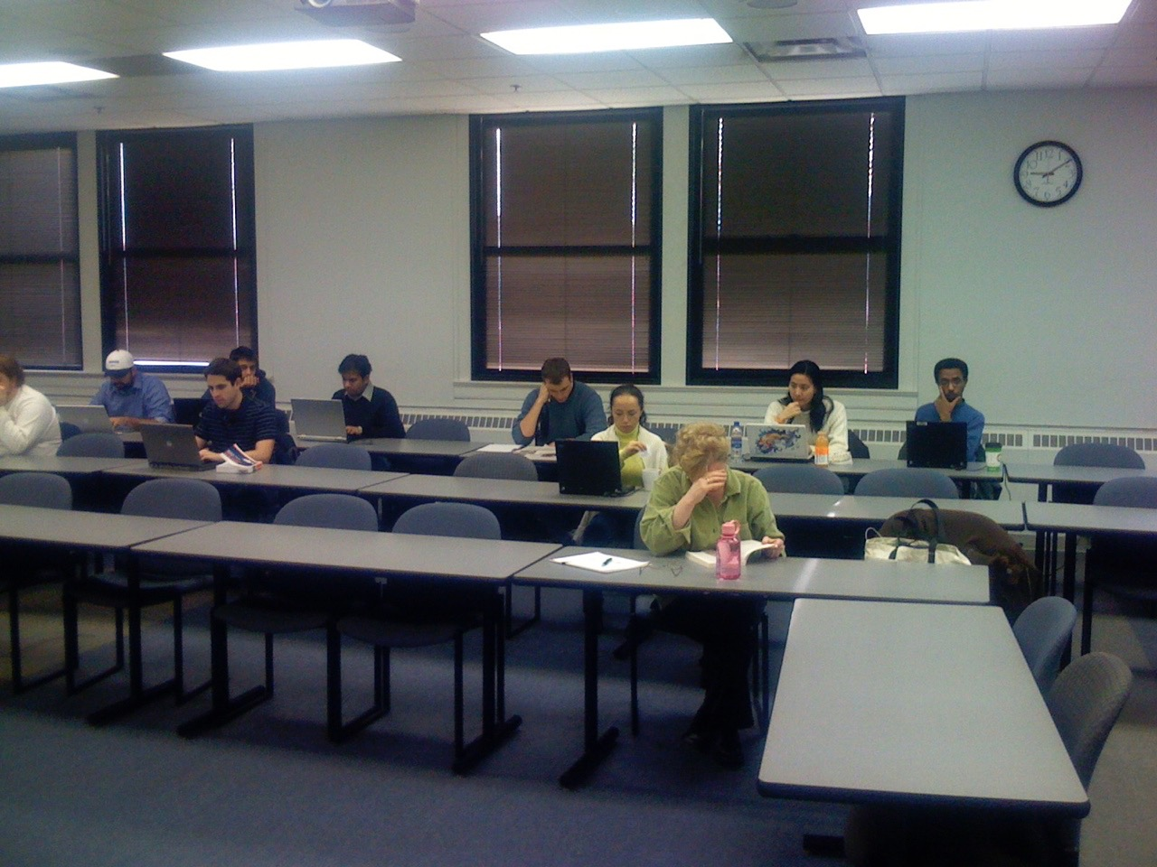
Teach
Relax
Reflect
Recharge
2007-2008

Slide 34
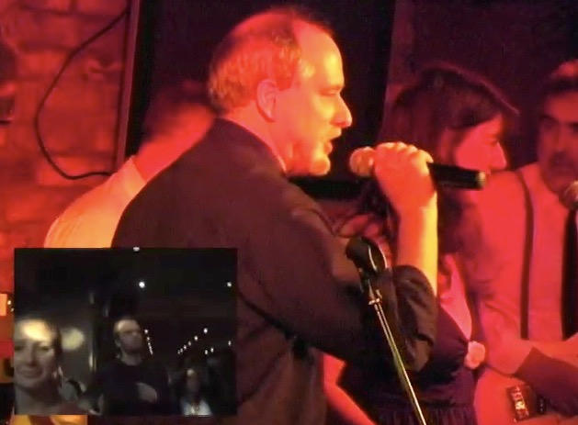

2008

Slide 35

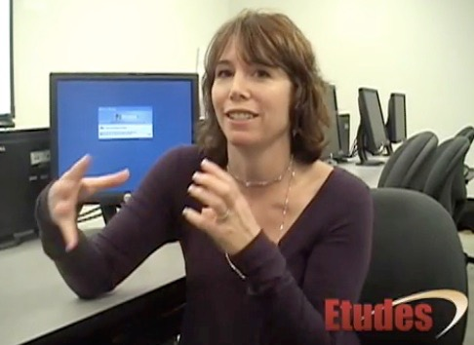
2008

Slide 36
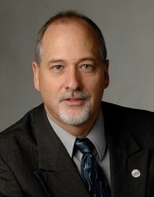
Tools
Interoperability
Commercial
Common
Cartridge
Publishers
LMS
Open Source
Standards
2008
www.imsglobal.org

Slide 37
Standards
IMS Tools Interoperability - Allows tools and content from multiple servers to be mashed up across the web
IMS Common Cartridge - Allows an interoperable cross-Learning System Import and Export of an entire class

Slide 38



IMS Common Cartridge
Angel Learning is shipping with IMS CC
D2L has announced support for IMS CC
Development of IMS CC support for Etudes is underway
McGraw Hill is producing Etudes-specific cartridges until IMS CC Support is available
2009

Slide 39




IMS Tools Interoperability
Demonstrations
IMS LTI
Tool
since
2004
2009

Slide 40



Slide 41


Slide 42


Slide 43

E T U D E S
G
O O G L E
Markup
IMS Learning Tools Interoperability
Technical Detail

Slide 44
TsugiProject Goals
Easy to Use Tool Building Environment (ETUBE?)
Supports IMS Learning Tools Interoperability
Written in Python, Free, Open Source
Hostable on Google for Free
Teachers writing tools - students writing tools (Thousands)
www.tsugiproject.org

Slide 45

High School
College
Freshman
Level
Programming
HTML CSS
Database
JavaScript

Slide 46

www.cloudsocial.org

Slide 47
After over a decade of effort, 2 million airplane miles, and four job changes, my goal is still to
find ways to put educational teachnology directly in the hands of teachers - so they can use it to teach.

Slide 48
My technical objective is to make it so that teachers can easily trade software and content between each other (like virtual baseball cards).
Regardless of what learning management system (or systems) their institution has adopted.

Slide 49
Thank you

